Slide 1
Internet stavri i servisi
Projekat3
Predrag Tosic - 18454

Slide 2






Tehnologije
Database - Postgres
Sensor – Python
Filter – Python
Dashboard – Python
NATS
MQTT Broker – Mosquitto
Command – React
Docker

Slide 3
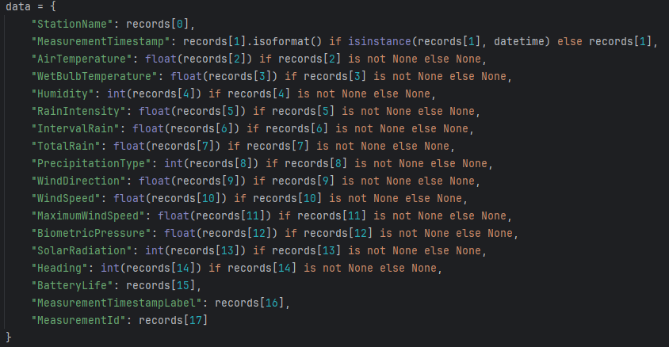
Data set – vremenska prognoza na plazama

Slide 4
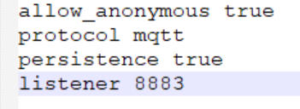
Mosquitto.conf

Slide 5
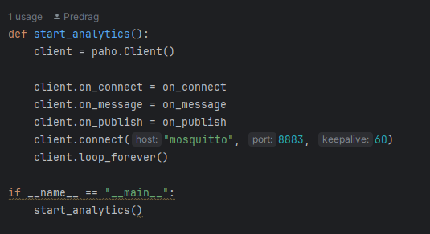
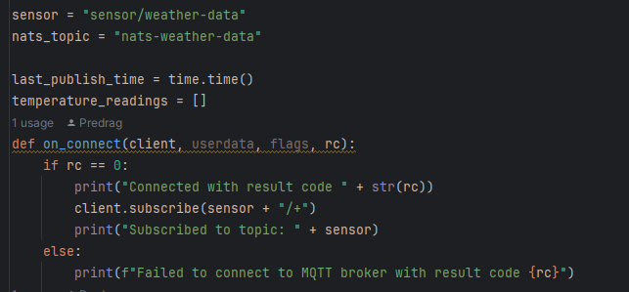
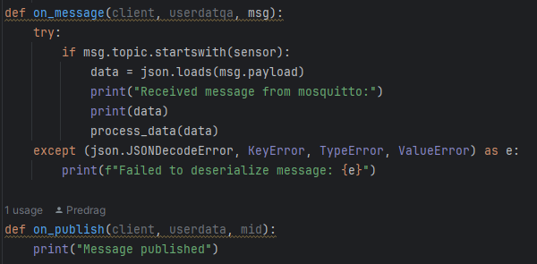
Filter – povezivanje na mqtt topic

Slide 6
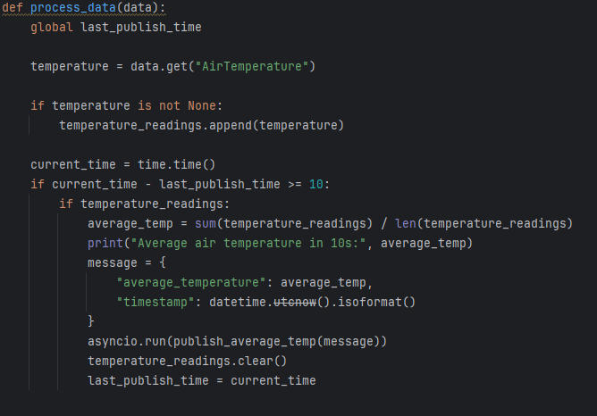
Filter – obrada podataka

Slide 7

Filter – slanje podataka na NATS topic

Slide 8
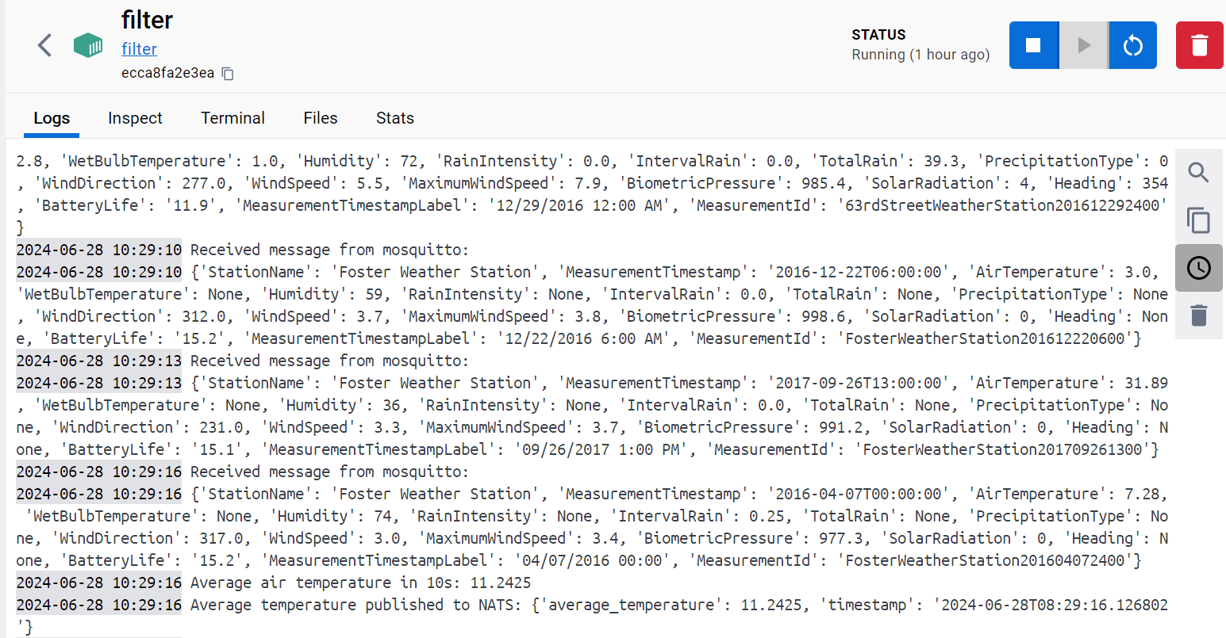
Filter - logs

Slide 9
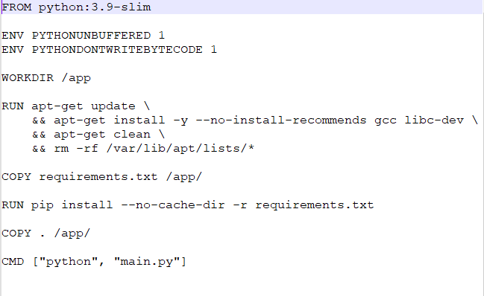
Filter – Dockerfile

Slide 10
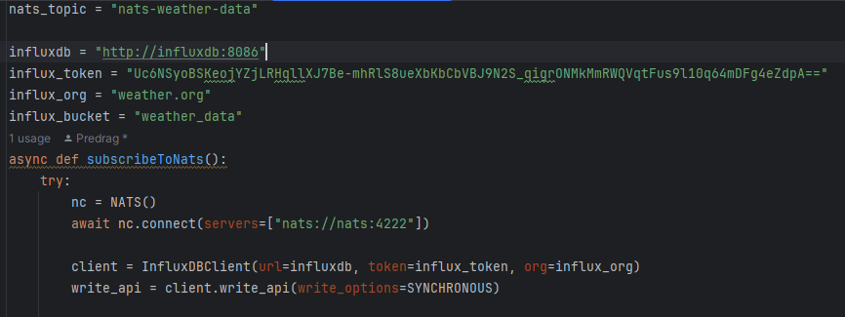
Dashboard

Slide 11
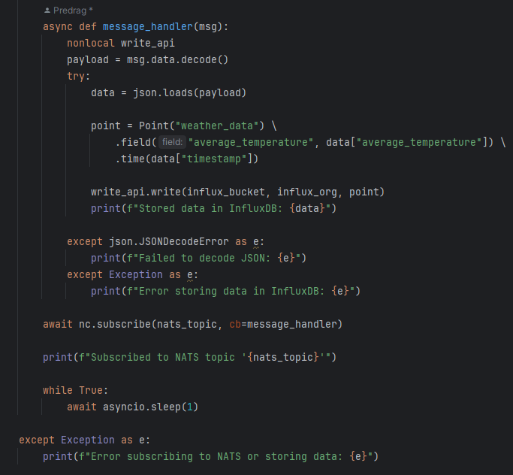
Dashboard

Slide 12
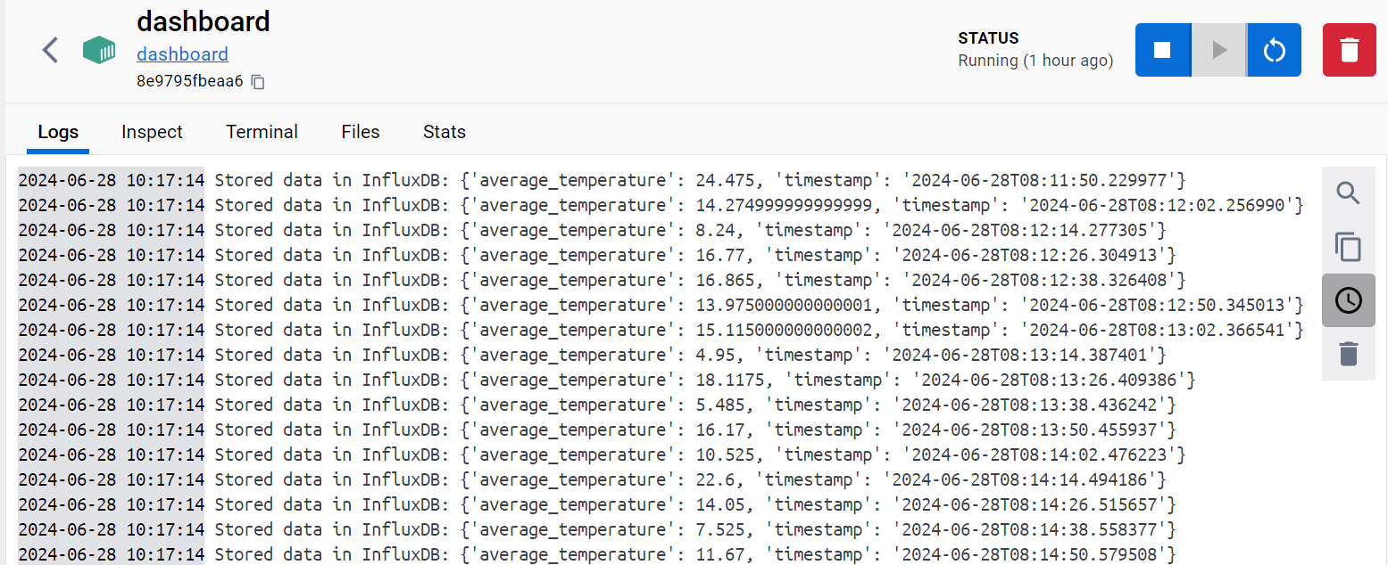
Dashboard - logs

Slide 13
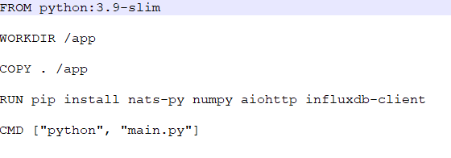
Dashboard – Dockerfile

Slide 14
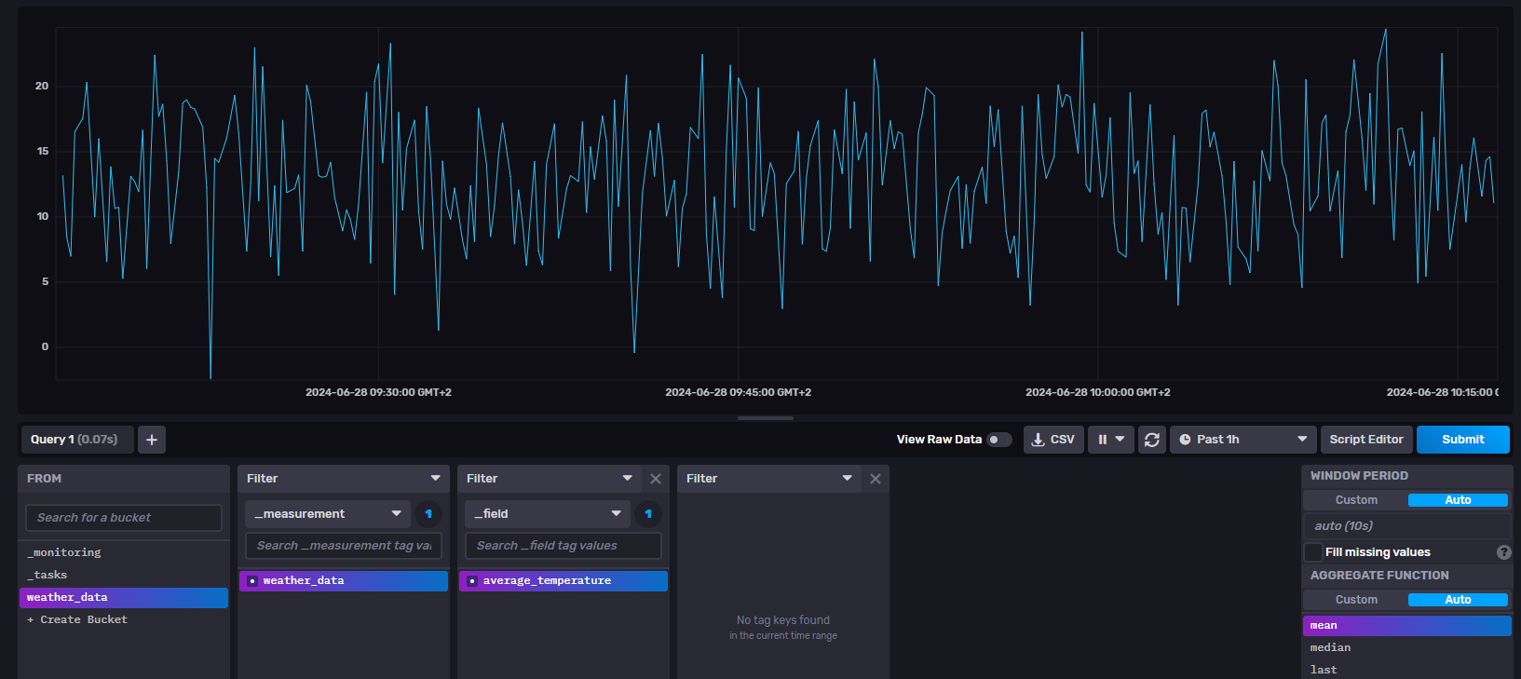
Influxdb

Slide 15
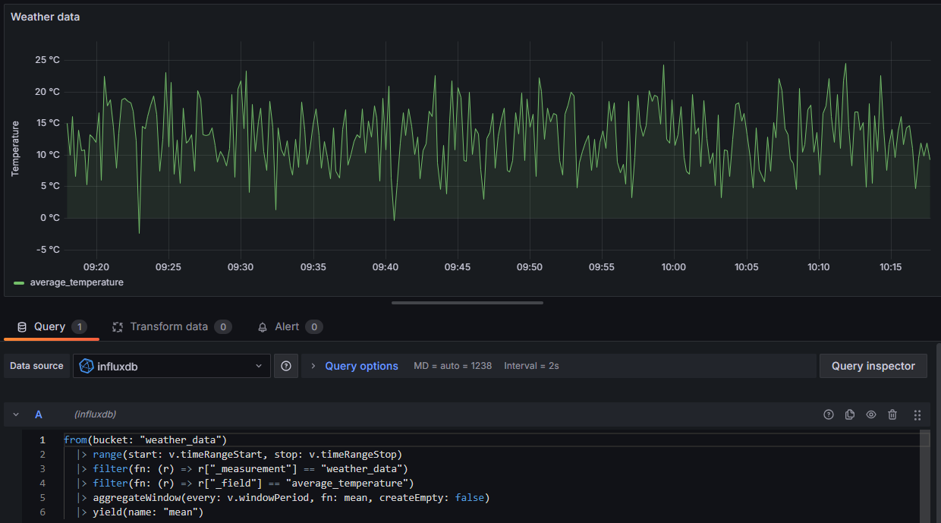
Grafana

Slide 16
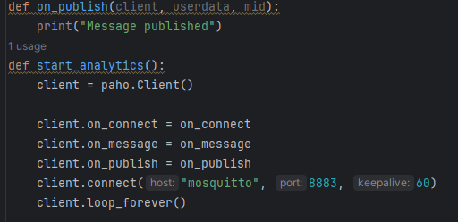
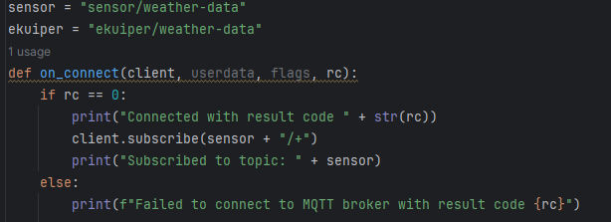
Ekuiper

Slide 17
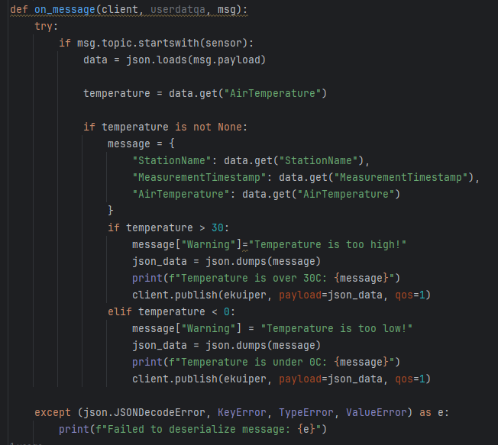
Ekuiper

Slide 18
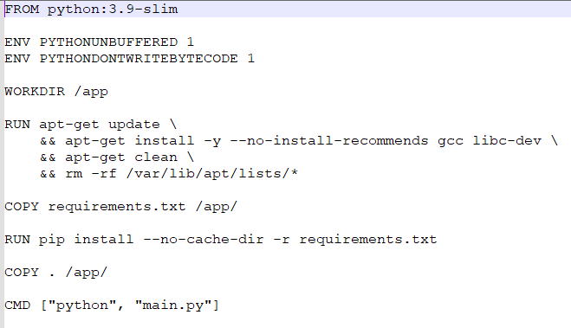
Ekuiper – Dockerfile

Slide 19
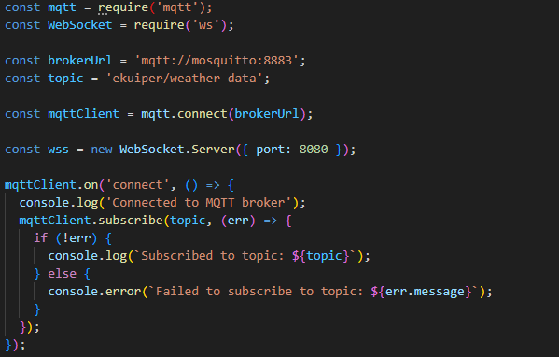
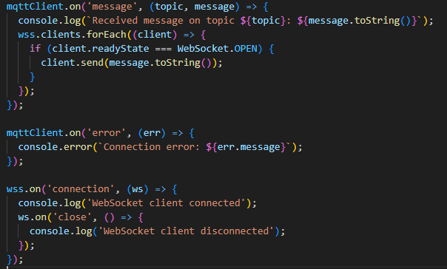
Command – mqtt service

Slide 20
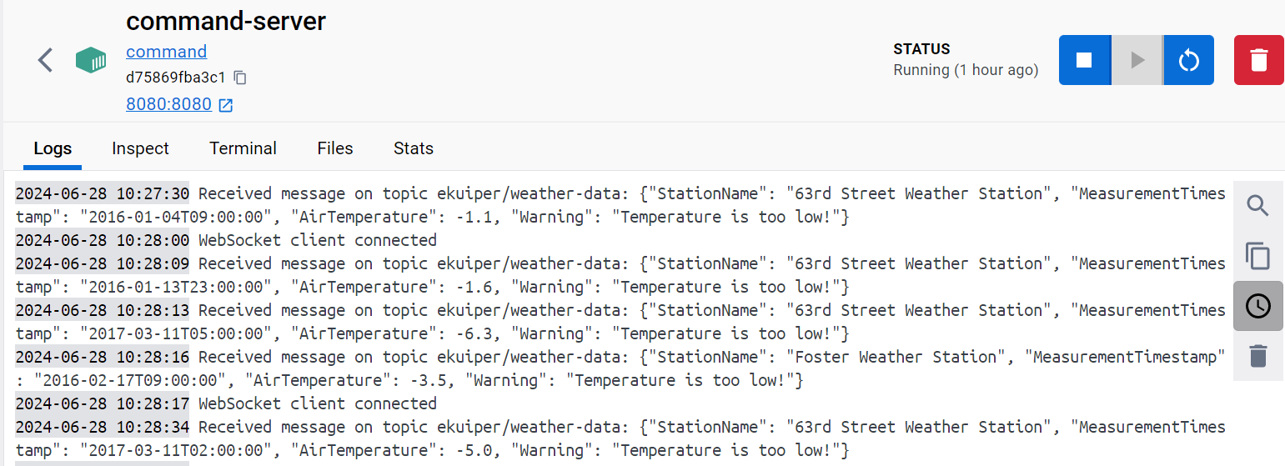
Command – mqtt service logs

Slide 21
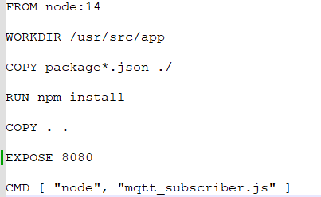
Command – mqtt service Dockerfile

Slide 22
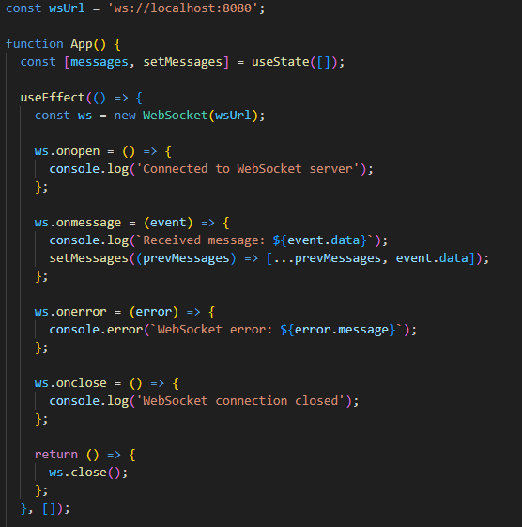
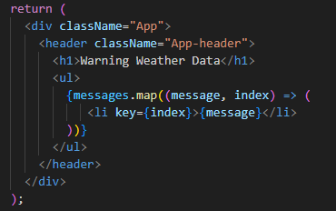
Command – Web page

Slide 23

Command – Web page

Slide 24
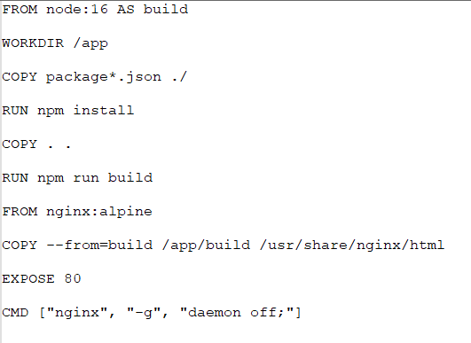
Command – Web page Dockerfile

Slide 25
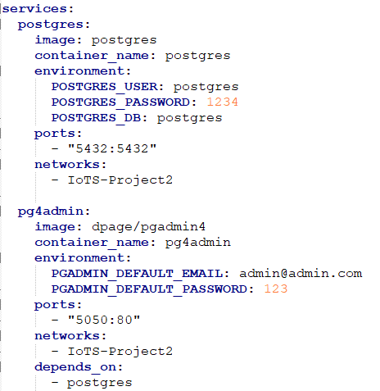
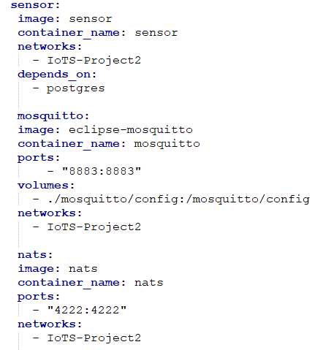
Docker-compose

Slide 26
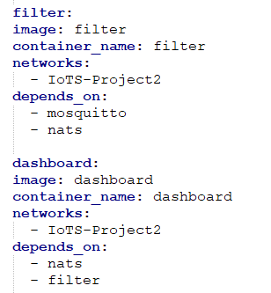
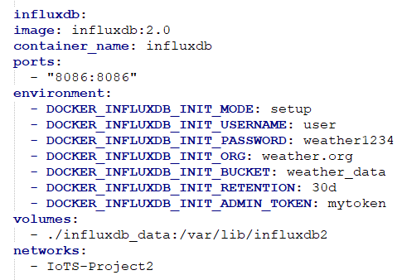
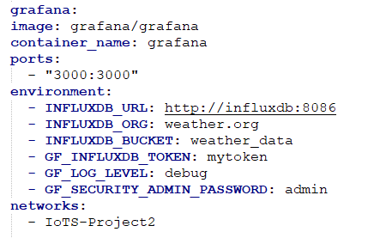
Docker-compose

Slide 27
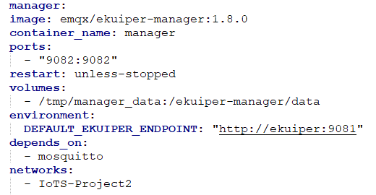
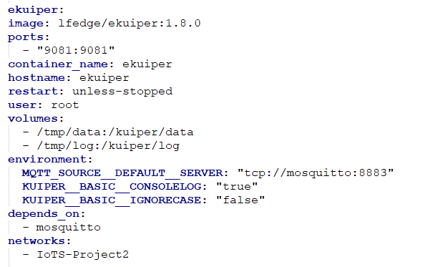
Docker-compose

Slide 28
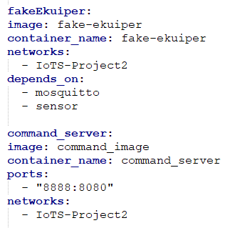
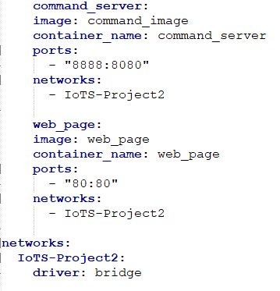
Docker-compose

